Slide 1
Rady Children’s Health Network (RCHN)
Authorization Training Workshop

Slide 2
Agenda
General Information
CHG/Molina Medi-Cal Members
Quick Reference Guides
Authorization Requirements
Notifications
EZ-Net Authorization Submission

Slide 3
Contact List
Utilization Management (UM) Operations Phone – 877-276-4543
EZ-Net – https://eznet.rchsd.org
EZ-Net Support – EZNetSupport@rchsd.org
Fax: 858-309-7977 or 858-309-6279
www.cpmgsandiego.com
  User Name – cpmgdocs
  Password – Resources25!

Slide 4
UM Operations Staff
Katie Coleman – Director, UM Operations
Rigoberto Estevez – Manager, UM Operations
Sonja Scott – Supervisor, UM Operations
Andi – UM Coordinator
Kai – UM Coordinator
Kay – UM Coordinator
Kevin – UM Coordinator
Kimberly – UM Coordinator
Kylie – UM Coordinator
MJ – UM Coordinator

Slide 5
RCHN Participating Health Plans
Aetna
Anthem Blue Cross
Blue Shield of California
  Blue Shield Promise Health Plan (Medi-Cal)
Cigna
Health Net
Scripps Health Plan
Sharp Health Plan
United Healthcare

Slide 6
Age Out Rules
RCHN is a pediatric only medical group, therefore members age out of the group and will need to move to an adult group at the age of 19. We are not able to consider exceptions to this requirement.
RCHN will cover members through the end of their birth month, the year they turn 19.
  Example: A member turning 19 on February 4, 2025, would be required to select a new medical group as of March 1, 2025.

Slide 7
Case Management
RCHN provides complex case management and care coordination for the following participating plans –
  Health Net
  Sharp Health Plan
  United Healthcare
Members can be referred by the provider office, or the member can request services, by calling 1-877-276-4543.

Slide 8
Molina
&
Community Health Group

Slide 9
Molina & Community Health Group (CHG)
These members are included under Rady Children’s Specialists of San Diego (RCSSD) and they are not part of the RCHN group.
Members are in San Diego County ONLY.
We do not provide member services support for these members. Members should be referred to Molina or CHG directly, not to RCHN.
Age Out Rules:
  Molina members age out the day prior to their 18th birthday.
    Example: The member turns 18 on 08/18/2025 – their last day with the group is 08/17/2025
  CHG members age out the last day of the month before the month of their 18th birthday.
    Example: The member turns 18 on 08/18/2025 – their last day with the group is 07/31/2025

Slide 10
Authorizations

Slide 11
Decision Turn Around Time (TAT)
Rules apply to all lines of business.
Urgent – 72 Hours
  Authorizations must meet the State of California provided definition of medical urgency – the treatment is needed to prevent serious deterioration in the member’s health.
Routine – 5 Business Days
Retrospective – 30 Calendar Days

Slide 12
Website Resources
www.cpmgsandiego.com
Resources available include (but are not limited to):
  Rosters
  Authorization Forms
  Claims/Billing Resources
  Provider Notifications
  Contact information for key staff

Slide 13
Second Opinion Consultations
Member requested 2nd opinions with an in-network provider should be processed using the normal RCHN authorization guidelines.
Member requested 2nd opinion with an out-of-network provider should be submitted to the health plan for processing. RCHN is not responsible for authorization processing for 2nd opinions outside of our contracted network.

Slide 14
California Children’s Services (CCS)
State program for children with qualifying medical conditions or diseases. Covers children up to 21 years of age.
Primary Payor for member’s with Medi-Cal coverage when they have a qualifying condition.
  What that means for you: Requests for services that are related to the condition that qualifies the member for CCS should be submitted to CCS first. If CCS indicates the service isn’t part of their qualifying condition, then the request could be submitted to RCHN for consideration.
    Example: The member has a cleft palate and needs speech therapy services – the request should be submitted to CCS for consideration first.
Administered county by county, contact information for local office:
  San Diego County – 619-528-4000

Slide 15
Authorization Request Form

Slide 16
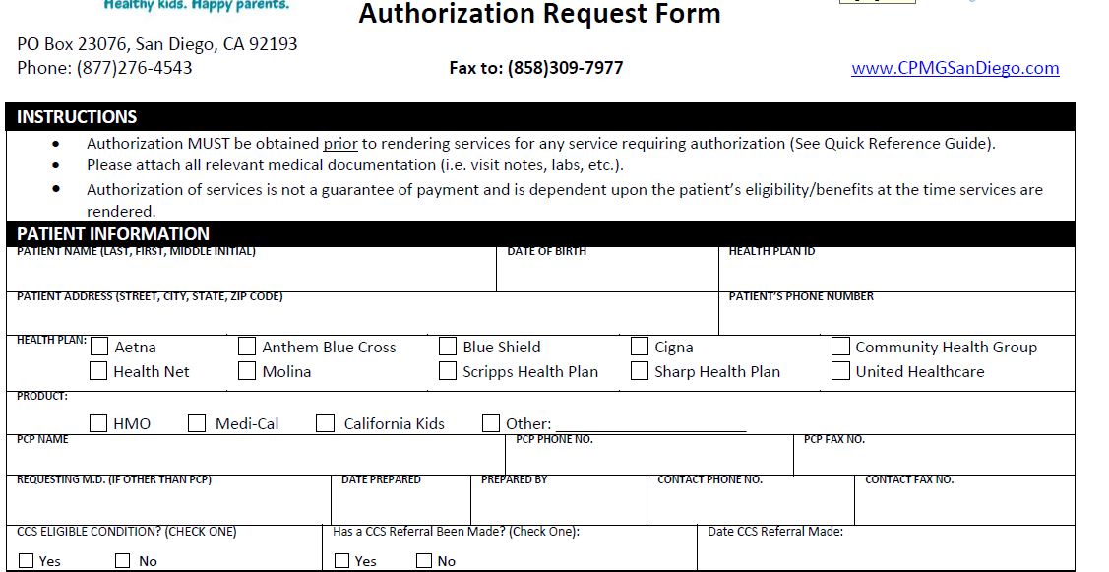

Slide 17
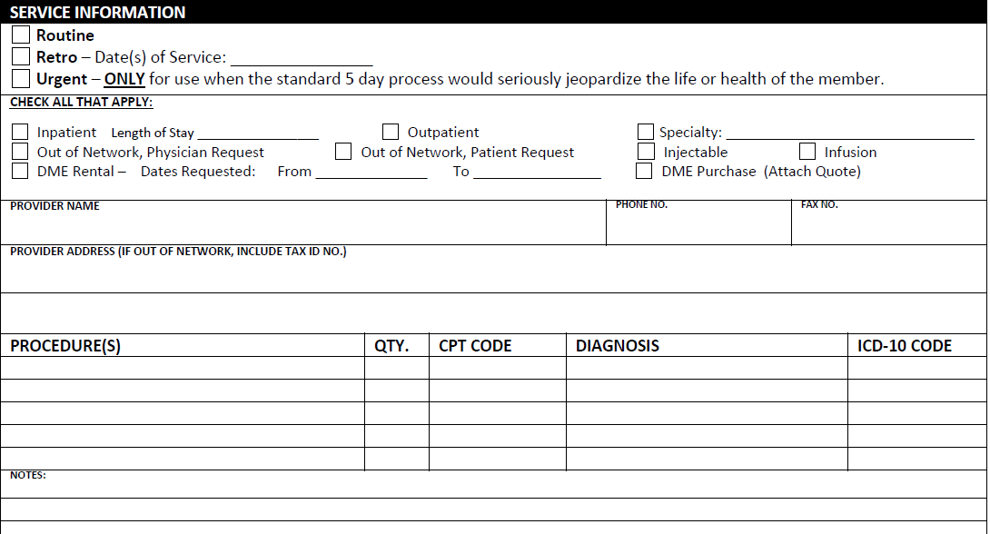

Slide 18
Quick Reference Guides

Slide 19
Ambulatory Blood Pressure Monitoring
Applies to RCHN, CHG, and Molina
The following services require authorization:
  Ambulatory Blood Pressure Monitoring
Required documentation:
  Clinical notes documenting the member’s medical condition and the timeframe of the medical condition that requires testing using ambulatory blood pressure monitoring.
  A valid, signed doctor’s order.

Slide 20
Acupuncture
Applies to RCHN, CHG, and Molina
The following services require authorization:
  All acupuncture services
Required documentation:
  Clinical notes documenting the member’s medical condition and the timeframe of the medical condition that requires treatment with acupuncture.
  A valid, signed doctor’s order.
  American Specialty Health (ASH) coverage – when a member’s plan shows coverage of acupuncture through ASH, the request for services must be submitted directly to ASH.

Slide 21
Bariatric Surgery Services
Applies to RCHN, CHG, and Molina
The following services require authorization:
  All Bariatric Surgery services
Required documentation:
  Clinical notes documenting the member’s medical condition, growth chart, current height and weight, lab test results, and any previous interventions.
  A valid, signed doctor’s order.
  Adolescent Program – only available in San Diego County at UCSD currently

Slide 22
Chiropractic
Applies to RCHN, CHG, and Molina
The following services require authorization:
  All chiropractic services
Required documentation:
  Clinical notes documenting the member’s medical condition and the timeframe of the medical condition that requires treatment with a chiropractor.
  A valid, signed doctor’s order.
  American Specialty Health (ASH) coverage – when a member’s plan shows coverage of chiropractic through ASH, the request for services must be submitted directly to ASH.

Slide 23
Circumcision
Applies to RCHN, CHG, and Molina
The following services require authorization:
  Initial New Patient Consultation with Urology for possible circumcision (possible diagnosis: phimosis, balanitis, etc.)
  Initial New Patient Consultation with General Surgery for possible circumcision (possible diagnosis: phimosis, balanitis, etc.)
  Circumcision (outside of the initial newborn period)
Required documentation:
  Clinical notes documenting the member’s medical condition and the timeframe of the medical condition that requires consideration of a circumcision.
  A completed RCHN Circumcision referral form.

Slide 24
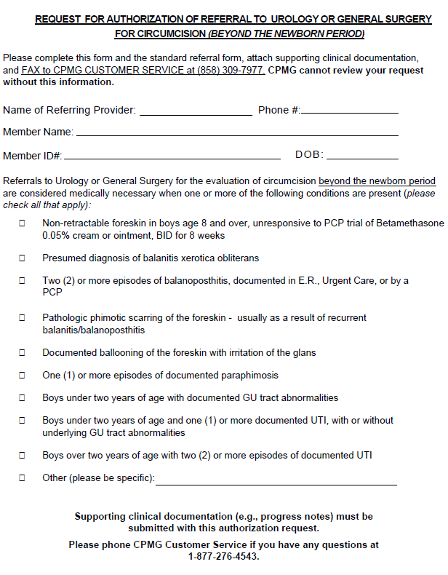

Slide 25
Cochlear Implants/Hearing Aids
Applies to RCHN
The following services require authorization:
  Cochlear implant surgery
  Hearing Aids/Hearing aid testing
  Cochlear Implant/Hearing Aid Supplies
Required documentation:
  Clinical notes documenting the member’s medical condition and the need for the requested service or supply.
  A valid, signed doctor’s order.

Slide 26
CT Scan/MRI
Applies to RCHN and CHG
The following services require authorization:
  CT Scan for diagnosis of headache or migraine
  MRI for diagnosis of headache or migraine
  MRI for diagnosis of TMJ (Medi-Cal ONLY)
Required documentation:
  Clinical notes documenting the member’s medical condition and the need for the requested service or supply.
  A valid, signed doctor’s order.
  A completed RCHN headache imaging form.

Slide 27
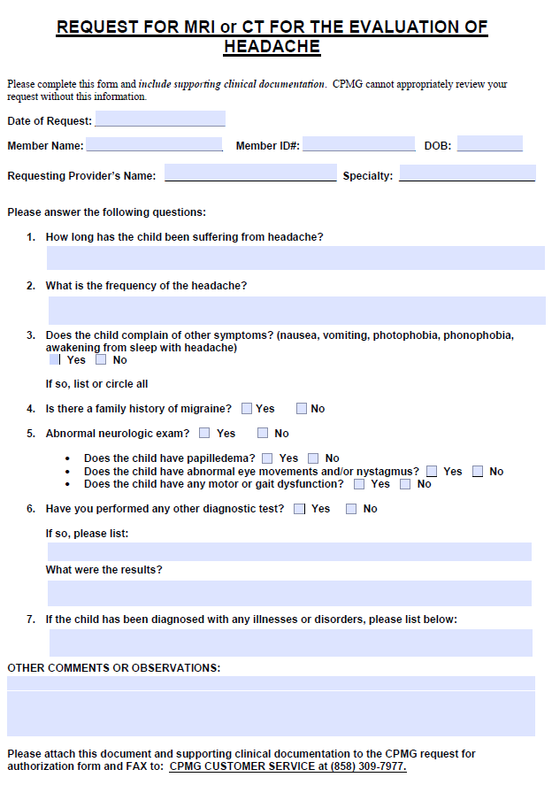

Slide 28
Dental Anesthesia
Applies to RCHN, CHG, and Molina
The following services require authorization:
  General Anesthesia for dental care
  Facility Fees
Required documentation:
  Clinical notes documenting the member’s medical condition and the need for the requested service or supply.
  A valid, signed doctor’s order.

Slide 29
Dermatology
Applies to RCHN, CHG, and Molina
The following services require authorization:
  Initial New Patient Consultation for diagnosis of acne only.
Required documentation:
  Clinical notes documenting the member’s medical condition and the need for the requested service or supply.
  A valid, signed doctor’s order.
  A completed RCHN Dermatology form.

Slide 30
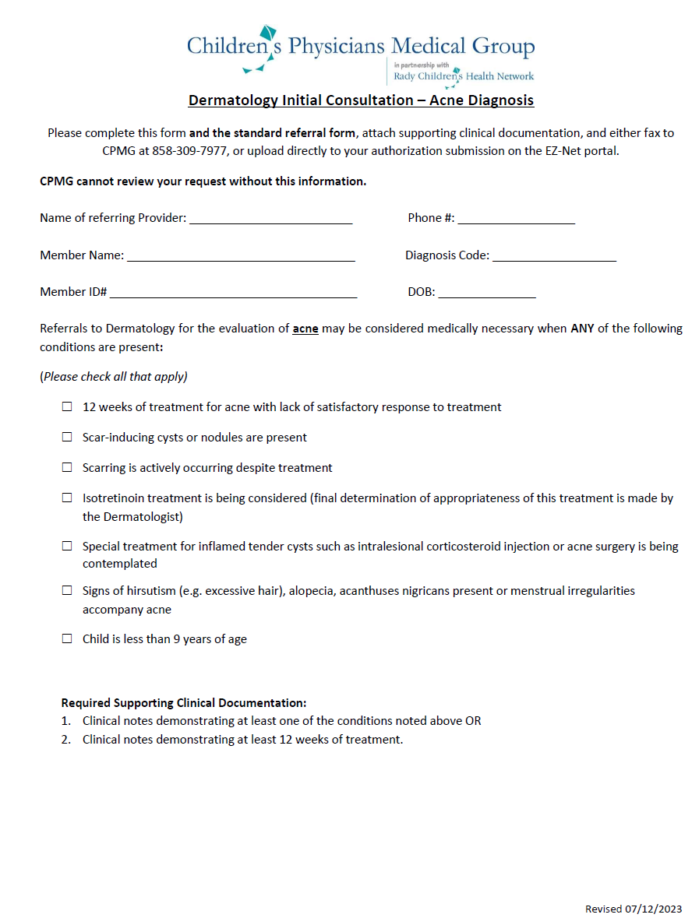

Slide 31
Developmental Behavioral Pediatrics
Applies to RCHN and CHG
The following services require authorization:
  All Developmental Behavioral Pediatric Services
Required documentation:
  Clinical notes documenting the member’s medical condition and the need for the requested service.
  A valid, signed doctor’s order.
  Member should be 6 years or older – members under that age should be directed to the Developmental Evaluation Clinic (DEC) at Rady Children’s.

Slide 32
Durable Medical Equipment (DME)/Orthotics & Prosthetics
Applies to RCHN
The following services require authorization:
  All Durable Medical Equipment
  All Orthotics & Prosthetics
Required documentation:
  Clinical notes documenting the member’s medical condition and the need for the requested equipment.
  A valid, signed doctor’s order.
  Price Quote (for customized equipment)

Slide 33
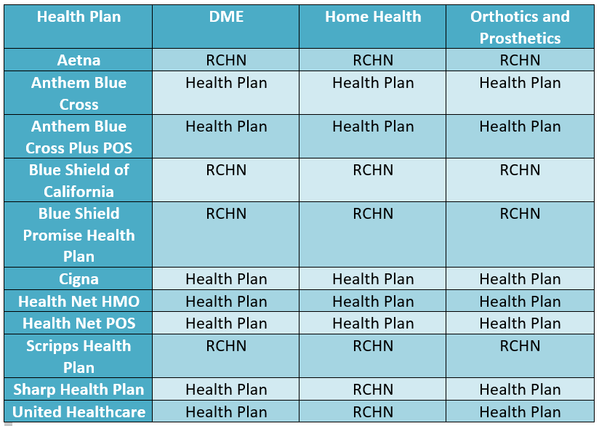
Vendor must be contracted with:

Slide 34
Dysphagia/Swallow Study
Applies to RCHN, CHG, and Molina
The following services require authorization:
  Dysphagia Study
  Swallow Study
  FEES Study
Required documentation:
  Clinical notes documenting the member’s medical condition and the need for the requested service.
  A valid, signed doctor’s order.

Slide 35
Ear, Nose, & Throat (ENT)
Applies to RCHN, CHG, and Molina
The following services require authorization:
  Initial New Patient Consultation for diagnosis of otitis media only.
Required documentation:
  Clinical notes documenting the member’s medical condition and the need for the requested service.
  Request for ENT Consultation Form
  A valid, signed doctor’s order.

Slide 36
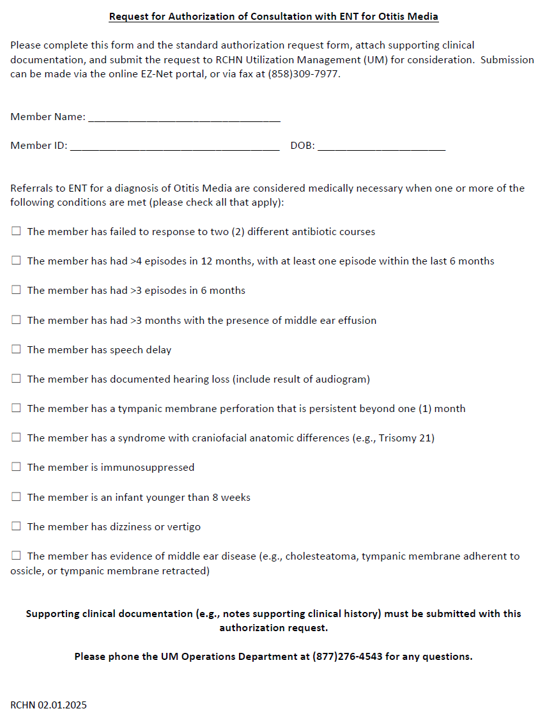

Slide 37
Endocrinology
Applies to RCHN, CHG, and Molina
The following services require authorization:
  Initial New Patient Consultation for diagnosis of Short Stature only.
Required documentation:
  Clinical notes documenting the member’s medical condition and the need for the requested service.
  A valid, signed doctor’s order.
  A completed RCHN Endocrinology for short stature form.

Slide 38
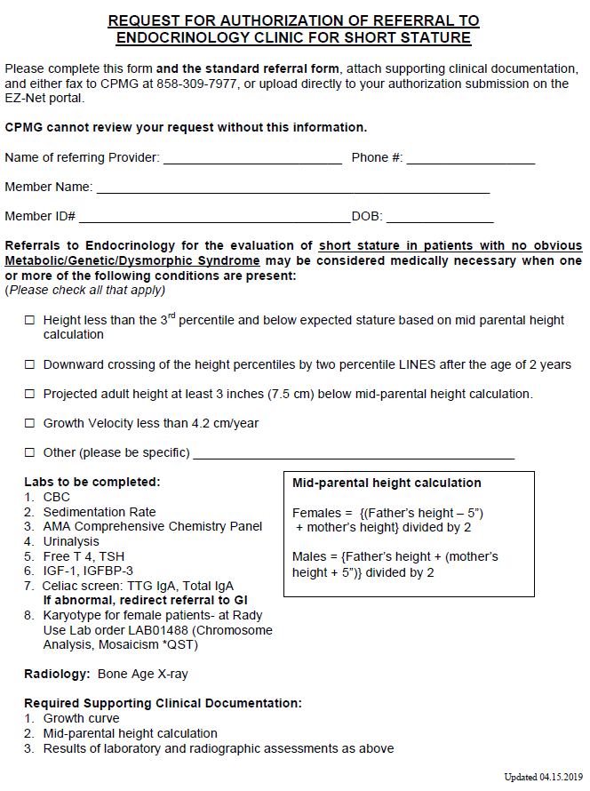

Slide 39
Gastroenterology
Applies to RCHN, CHG, and Molina
The following services require authorization:
  Initial New Patient Consultation for diagnosis of Abdominal Pain only.
  Initial New Patient Consultation for diagnosis of Constipation or Reflux
Required documentation:
  Clinical notes documenting the member’s medical condition and the need for the requested service.
  A valid, signed doctor’s order.
  A completed RCHN Gastroenterology form.

Slide 40
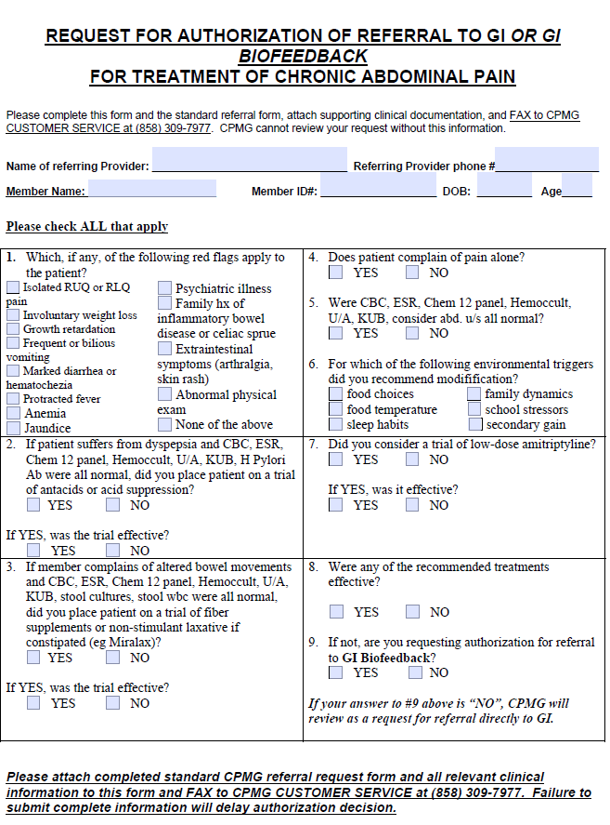

Slide 41
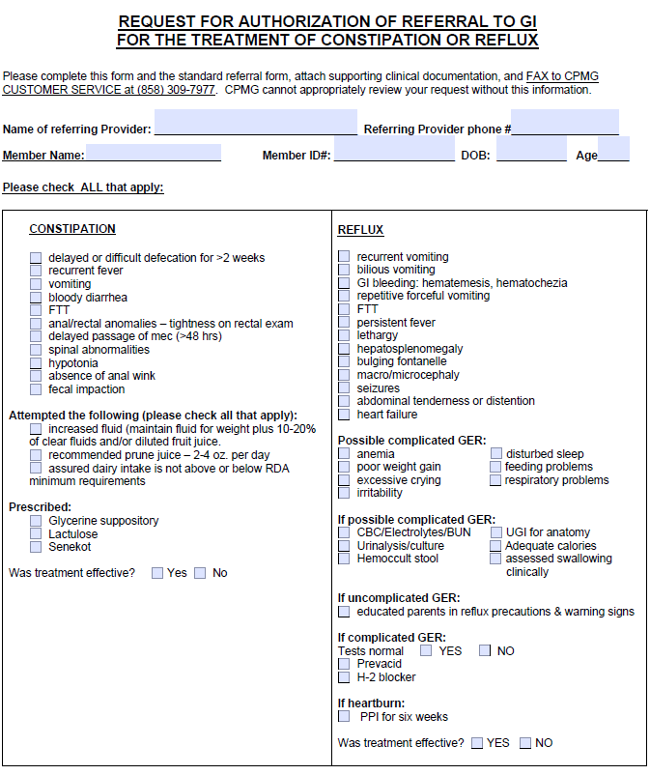

Slide 42
Genetic Testing
Applies to RCHN, CHG, and Molina
The following services require authorization:
  All genetic testing
Required documentation:
  Clinical notes documenting the member’s medical condition and the need for the requested service.
    Documentation should include information on how the testing may impact the future care of the member.
  A valid, signed doctor’s order.

Slide 43
Home Health Services
Applies to RCHN and Molina
The following services require authorization:
  All Home Health Services
  All Shift Nursing, Private Duty Nursing, or Skilled Nurse Services
Required documentation:
  Clinical notes documenting the member’s medical condition and the need for the requested service.
  A valid, signed doctor’s order.

Slide 44
Infused or Injected Medications
Applies to RCHN, CHG, and Molina
The following services require authorization:
  All injectable medications (see exclusion list)
  All infused medications (see exclusion list)
Required documentation:
  Clinical notes documenting the member’s medical condition and the need for the requested service.
  A valid, signed doctor’s order.
  Growth Hormone injections – a completed RCHN growth hormone form.

Slide 45
Excluded Infused or Injected Medications
The following services are not authorized by RCHN:
  Medi-Cal
    Factor VIII Medications (CCS State Office)
    CHG Members - All infused medications
    Home Self-Injectables (Medi-Cal Rx)
  Commercial
    Cigna Members – All injectable medications
    Health Net Members – Injectable Medication Grid
The following services do not require authorization:
  Allergy Injections
  Antibiotics
  Vaccines
  Solu-Medrol
  Iron Sucrose/Ferric Gluconate
  Chemotherapeutic Agents for the treatment of cancer

Slide 46
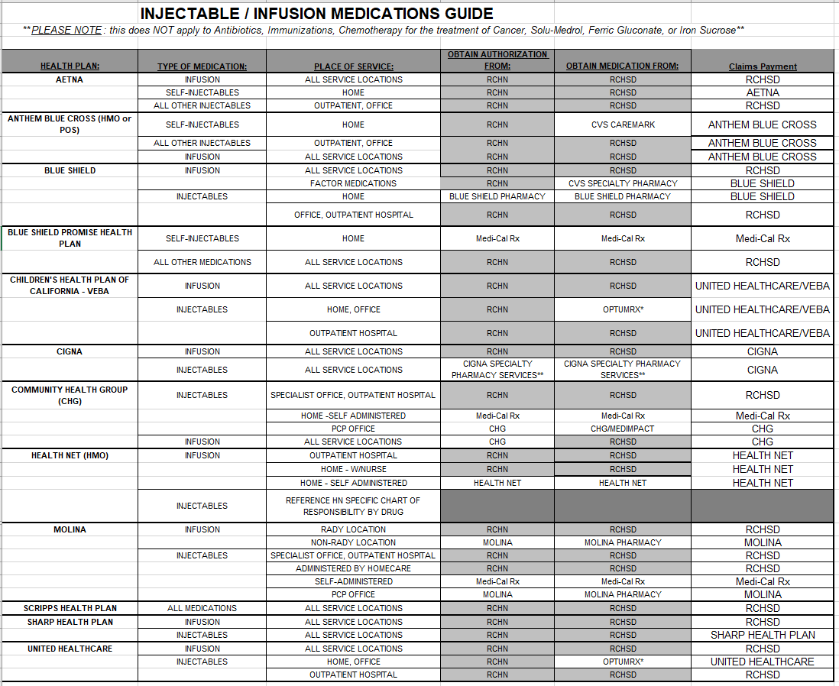

Slide 47
Neuropsychology
Applies to RCHN and CHG
The following services require authorization:
  All Neuropsychology Services
Required documentation:
  Clinical notes documenting the member’s medical condition and the need for the requested service.
  A valid, signed doctor’s order.

Slide 48
Nutrition Counseling
Applies to RCHN
The following services require authorization:
  All nutrition counseling or weight management services
Required documentation:
  Clinical notes documenting the member’s medical condition and the need for the requested service.
  Growth chart, current height and weight, and any lab testing results.
  A valid, signed doctor’s order.
  Obesity Diagnosis – a completed RCHN obesity form.

Slide 49
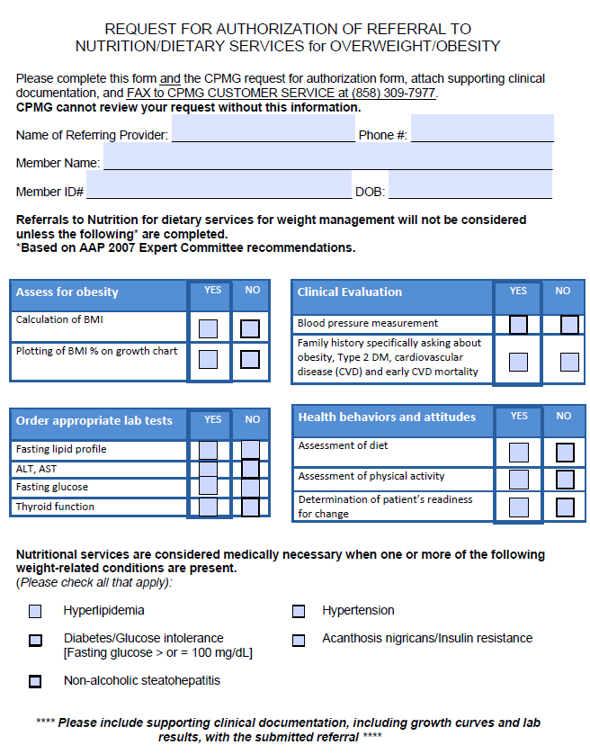

Slide 50
Ophthalmology/Vision Services
Applies to RCHN
The following services require authorization:
  Refraction related to a vision diagnosis
Required documentation:
  Clinical notes documenting the member’s medical condition and the need for the requested service.
  A valid, signed doctor’s order.

Slide 51
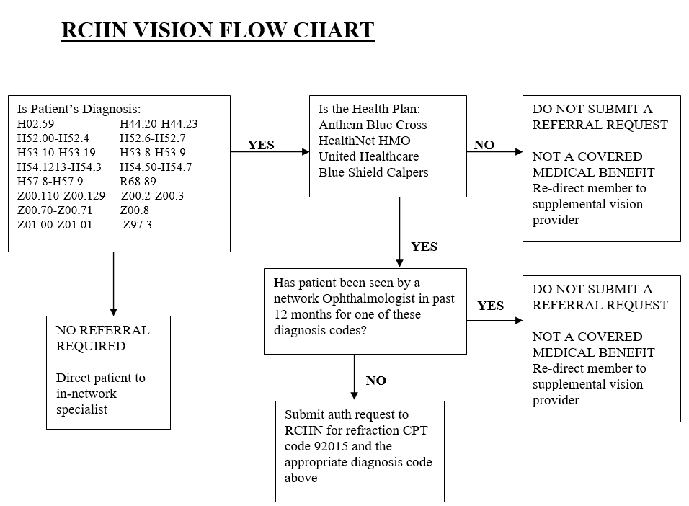

Slide 52
Out of Network Services
Applies to RCHN, CHG, and Molina
The following services require authorization:
  All services being performed by a non-contracted or out-of-network provider (a provider not included on the RCHN rosters)
Required documentation:
  Documentation of whether the request to go out-of-network is being made by the parent or the provider.
  Documentation of whether services within the network would appropriately meet the needs of the member, or if treatment in-network has previously been provided.
  Clinical notes documenting the member’s medical condition and what services or testing have been completed prior to submitting the request to go out-of-network.

Slide 53
PET Scan
Applies to RCHN and CHG
The following services require authorization:
  All PET Scans
Required documentation:
  Clinical notes documenting the member’s medical condition and the need for the requested service.
  A valid, signed doctor’s order.

Slide 54
Radiation Oncology
Applies to RCHN, CHG, and Molina
The following services require authorization:
  All Radiation Oncology Services (provided at UCSD)
  Proton Beam Therapy
Required documentation:
  Clinical notes documenting the member’s medical condition and the need for the requested service.
  A valid, signed doctor’s order.

Slide 55
Rheumatology
Applies to RCHN, CHG, and Molina
The following services require authorization:
  Initial New Patient Consultation
Required documentation:
  Clinical notes documenting the member’s medical condition and the need for the requested service.
  A valid, signed doctor’s order.
  A completed RCHN Joint Pain form.

Slide 56
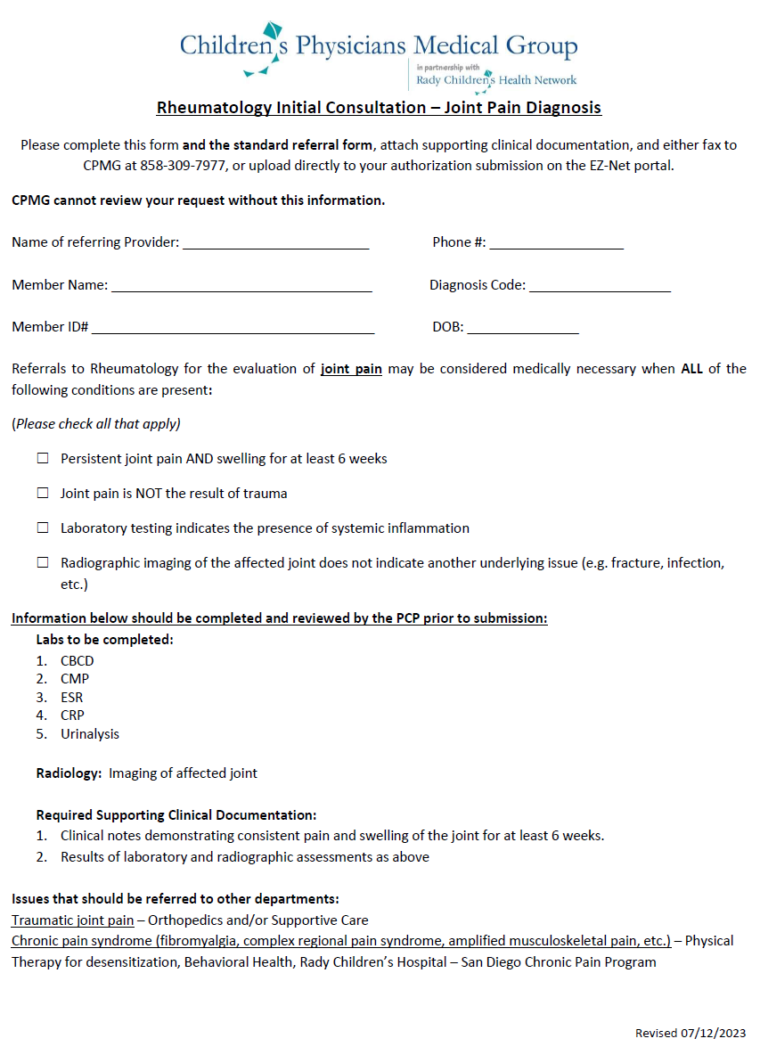

Slide 57
Surgical Procedures
Applies to RCHN, CHG, and Molina
The following services require authorization:
  All Oral Surgery services (office visits & procedures)
  All Plastic Surgery procedures
  All Reconstructive or Cosmetic procedures
    Examples: laser skin procedures, laser hair removal, NUSS procedures, Gynecomastia surgery, etc.
Required documentation:
  Clinical notes documenting the member’s medical condition and the need for the requested service.
  A valid, signed doctor’s order.

Slide 58
Therapy
Applies to RCHN, CHG, and Molina
The following services require authorization:
  Occupational Therapy evaluation or treatment
  Physical Therapy evaluation or treatment
  Speech Therapy evaluation or treatment
  Swallow related therapy evaluation or treatment
Required documentation:
  Clinical notes documenting the member’s medical condition
  Evaluation Report (if the request is for treatment) that includes the number of recommended visits and the duration of treatment.
  A valid, signed doctor’s order.

Slide 59
Therapy - School Services
Children are eligible to receive speech therapy services via the public school system once they reach the age of 3 years.
Any members being placed on a waiting list, or who are unable to schedule for services within 15 business days, should be advised that they may be able to access services via their local school district at no cost to the member family.
Refer to the school district contact list provided.

Slide 60
Transportation
Applies to RCHN Medi-Cal – Blue Shield Promise Health Plan
The following services require authorization:
  Non-Emergency Medical Transportation (NEMT)
    Wheelchair Van
    Litter/Gurney Van
    Ambulance
Required documentation:
  Clinical notes documenting the member’s medical condition
  A valid, signed doctor’s order.
  A completed Physician Certification Statement Form

Slide 61
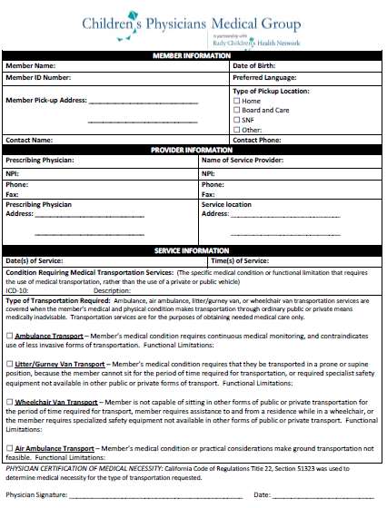

Slide 62
RCHN Excluded Services
Services not authorized by RCHN:
  Behavioral Health Services (including ABA Therapy)
  Dental Services
  Non-Medical Transportation
  Pharmacy Services (oral medications or medications received via a retail pharmacy)
  Health Net ONLY – Developmental Behavioral Pediatrics
  Cigna ONLY – Therapy (Occupational, Speech, or Physical) when related to a diagnosis of Autism.

Slide 63
CHG Excluded Services
Services not authorized by Rady Children’s:
  Behavioral Health Services (including ABA Therapy)
  Cochlear Implants/Hearing aids
  Dental Services
  Durable Medical Equipment/Orthotics & Prosthetics
  Home Health Services
  Home Self-Injectable medications
  Infused medications
  Inpatient Admissions
  Non-Medical Transportation
  Oral Medications/Pharmacy services
  Shift Nursing
  Transplants
  Vision Services

Slide 64
Molina Excluded Services
Services not authorized by Rady Children’s:
  Behavioral Health Services (including ABA Therapy)
  Cochlear Implants/Hearing aids
  Dental Services
  Developmental Behavioral Pediatrics (Behavioral Health Plan)
  Durable Medical Equipment/Orthotics & Prosthetics
  Home Self-Injectable medications
  Neuropsychology Services (Behavioral Health Plan)
  Non-Medical Transportation
  Oral Medications/Pharmacy services
  Radiology Services
  Shift Nursing
  Transplants
  Vision Services

Slide 65
Appeals & Grievances

Slide 66
Peer to Peer Requests
If an authorization is denied or modified, a provider may request reconsideration of the decision using one of the following methods:
  Phone call to UM Operations Department to request a peer-to-peer discussion (clinicians ONLY)
  Submission of written documentation via fax.
    Must include either additional clinical notes or a letter explaining the reason for reconsideration.
  Direct message via Epic or secure e-mail to the RCHN Medical Directors.

Slide 67
Member Appeals
Members have the right to file an appeal for any denial or modification.
Member appeals must be filed directly with the health plan and can be initiated by calling the member services phone number identified on their member ID card.
  Appeals can be filed in writing using the resources included in the letter of denial or modification.

Slide 68
Grievances
Grievances are a form of complaint and are not related to authorizations.
Grievances must be filed directly with the health plan and can be initiated by calling the member services phone number.
If a member files a grievance an office is expected to respond in writing to the issue raised by the member. A comprehensive response is essential in determining the validity of the complaint.

Slide 69
Notifications

Slide 70
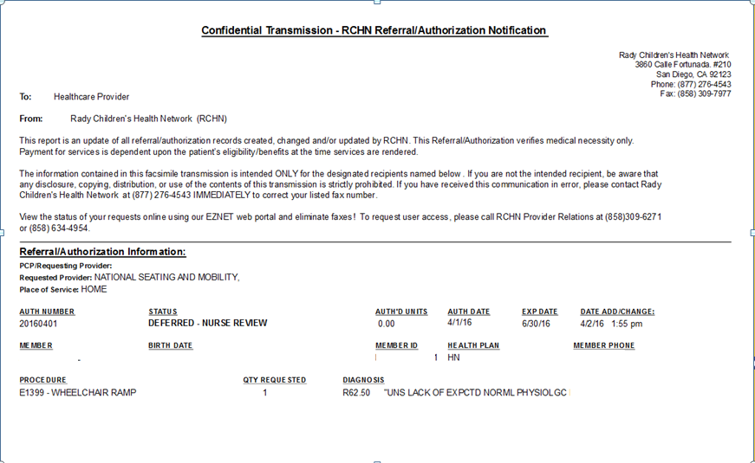

Slide 71
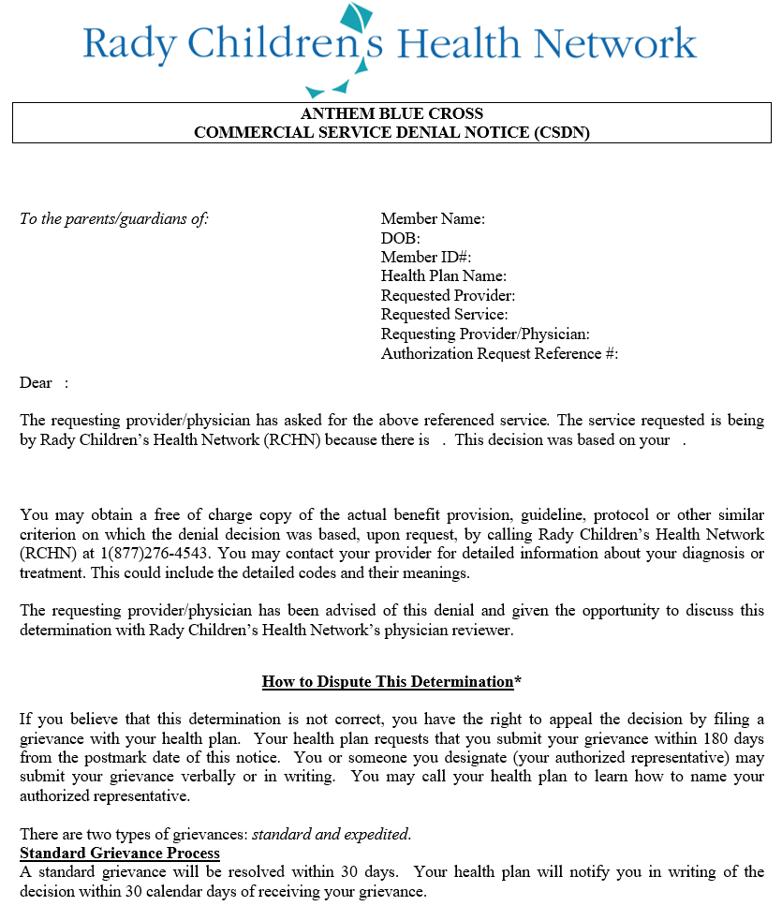

Slide 72
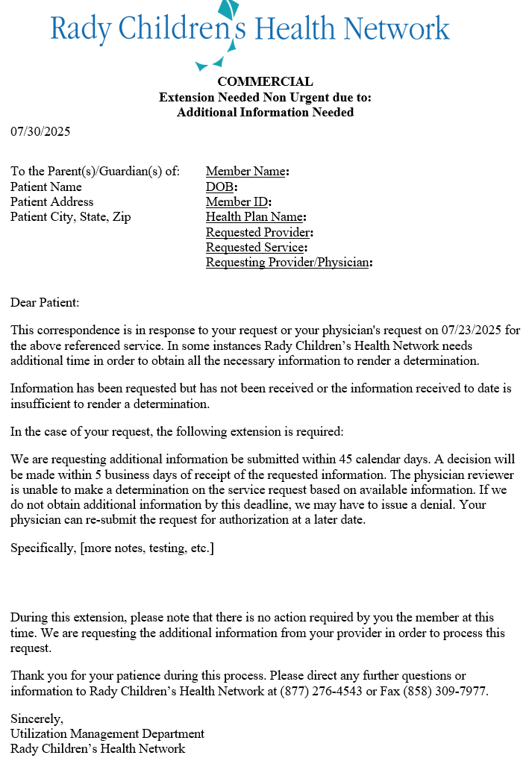

Slide 73
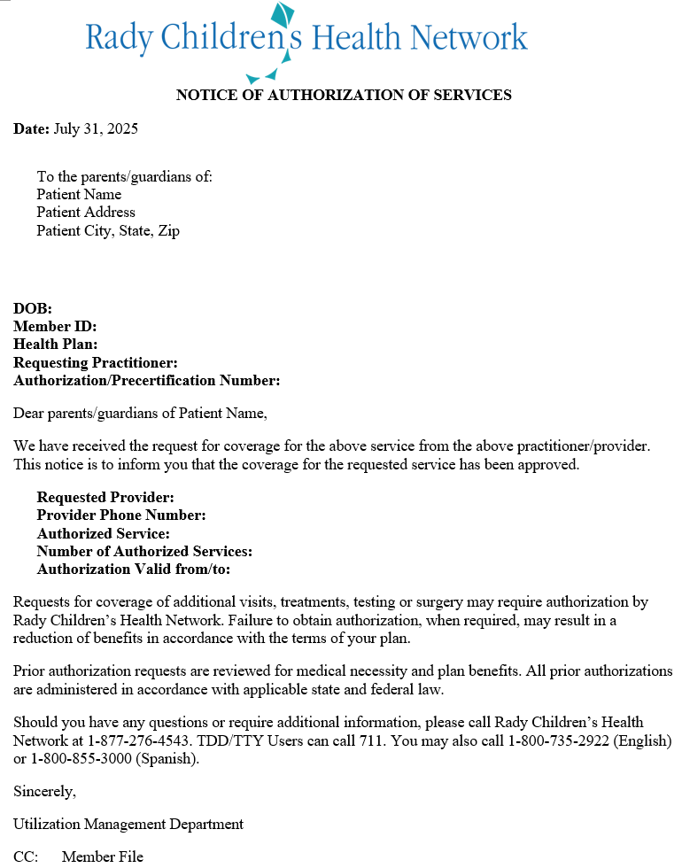

Slide 74
Questions?

